Slide 1
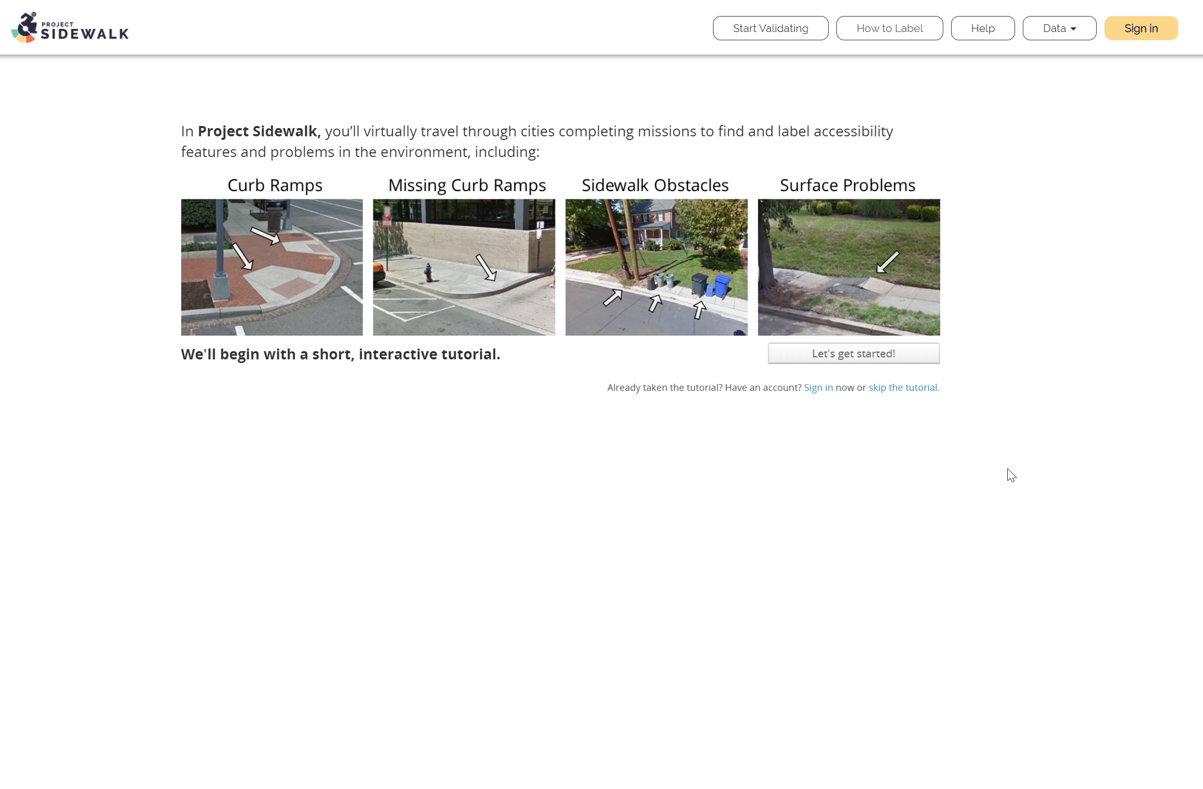

Slide 2
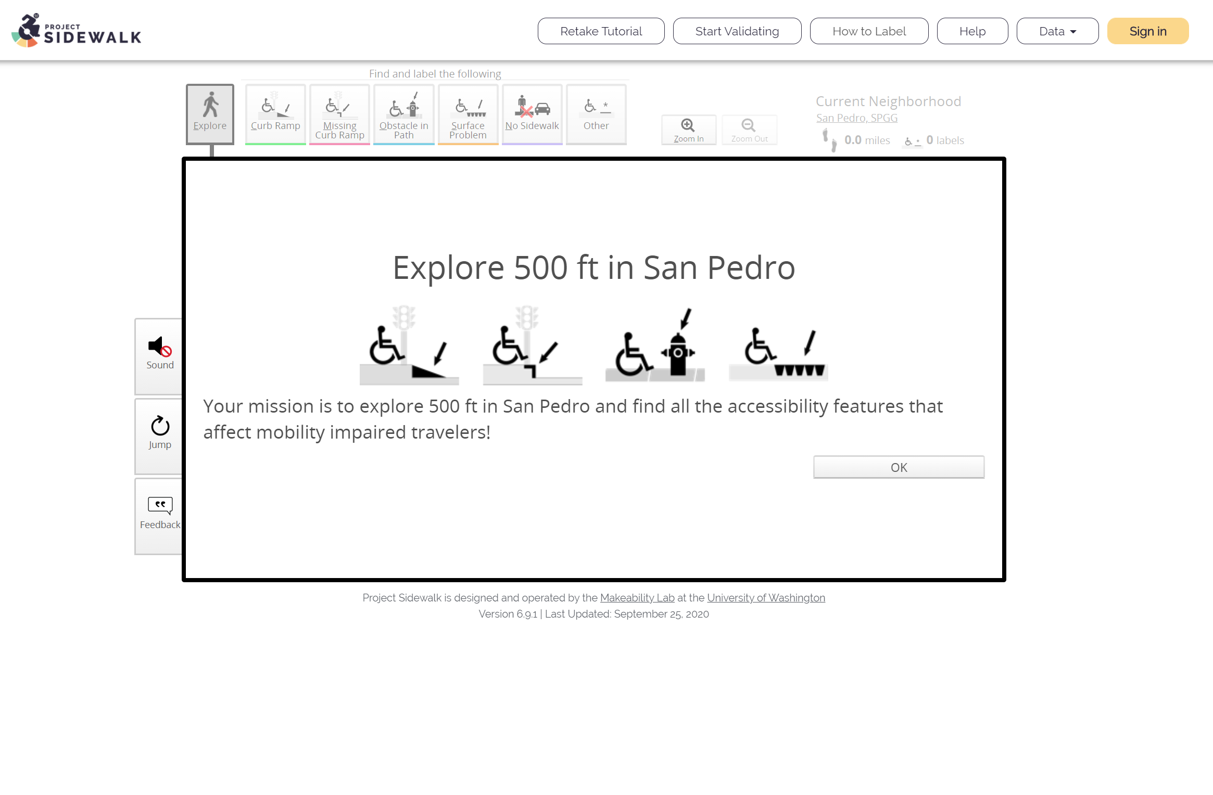

Slide 3
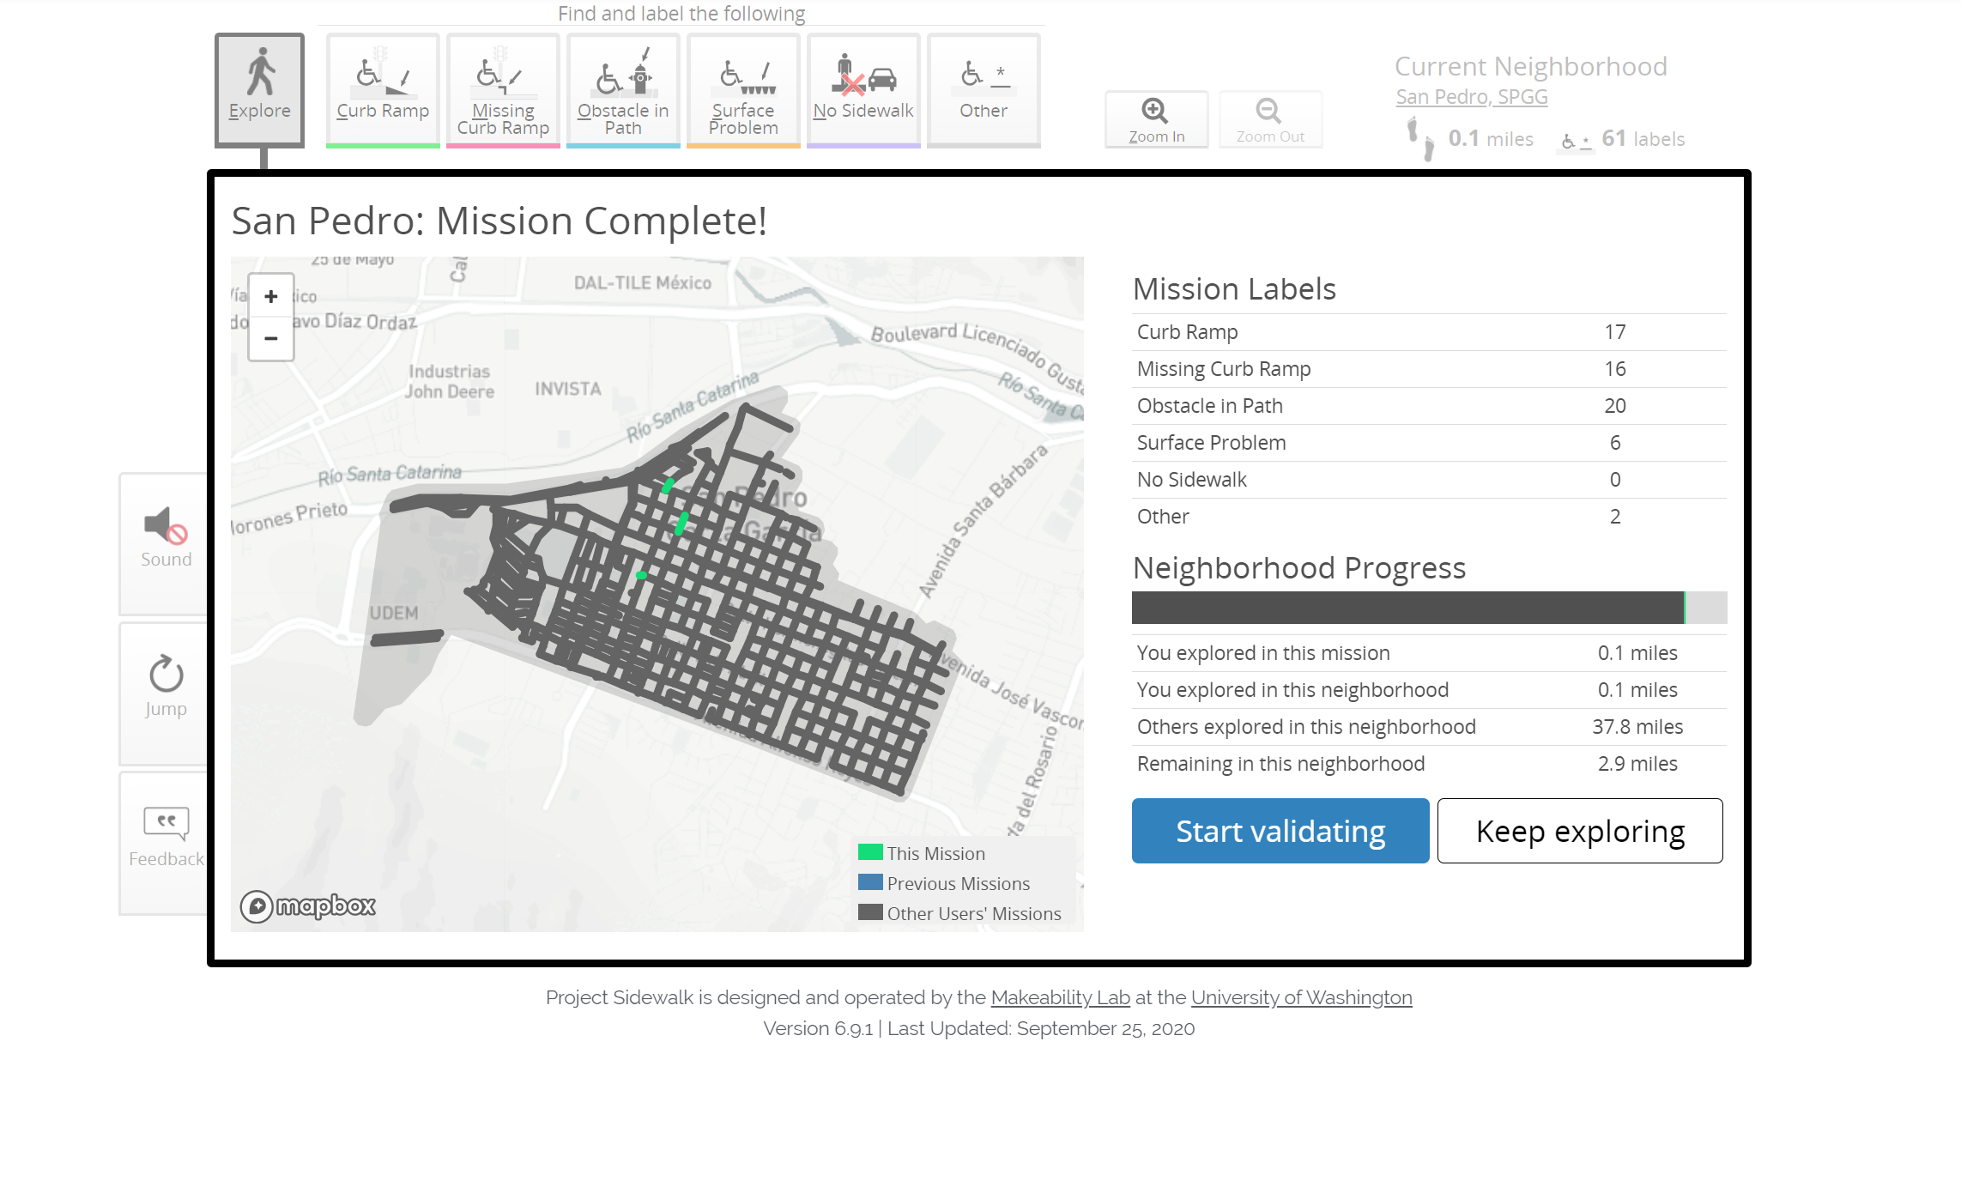

Slide 4
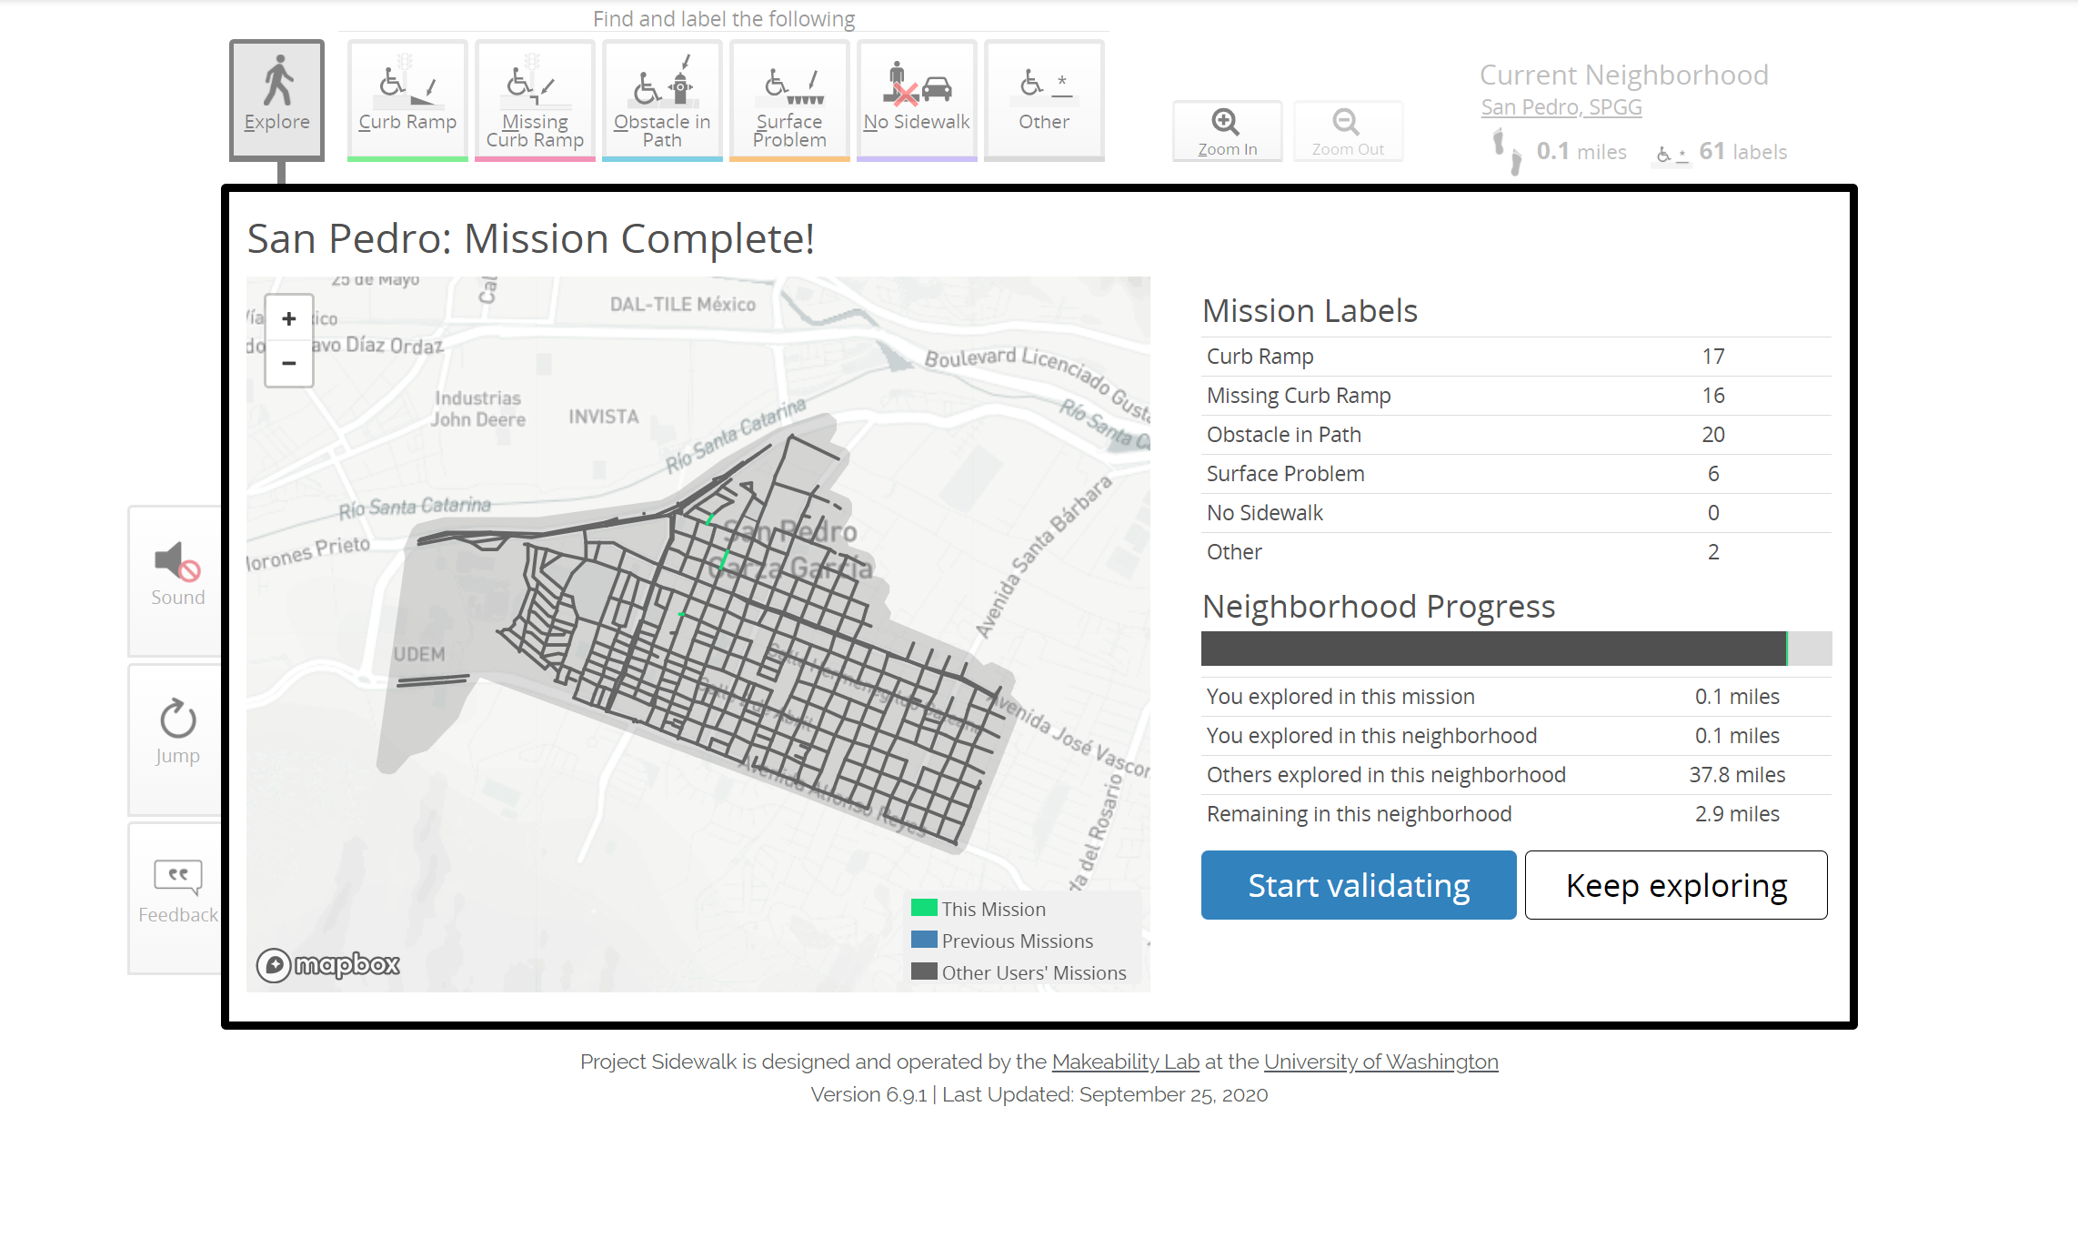

Slide 5
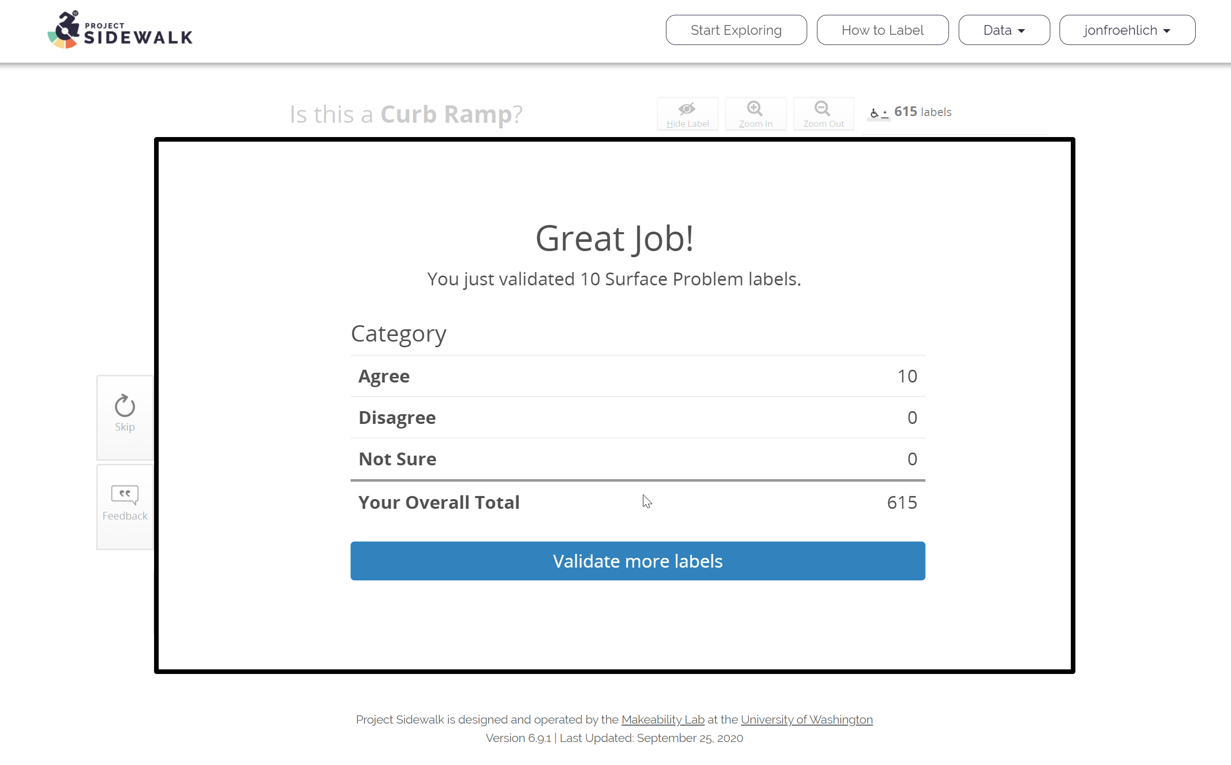

Slide 6





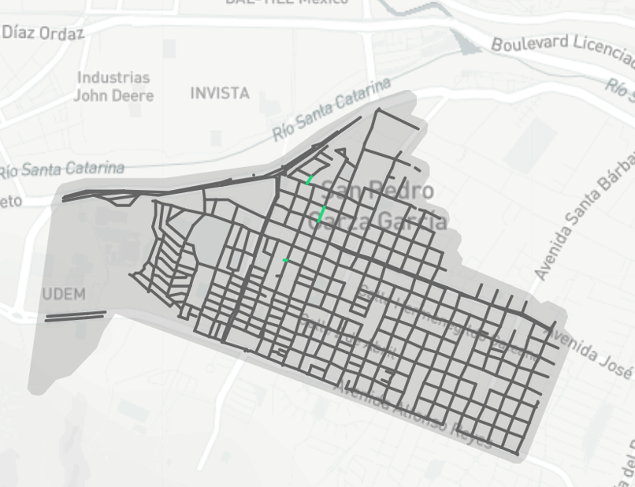

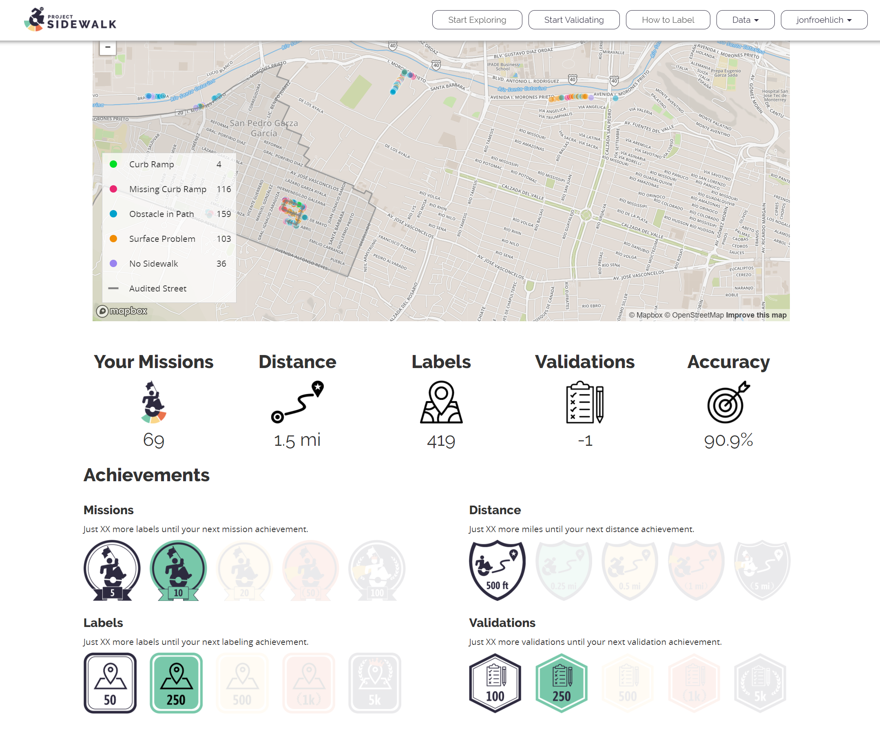


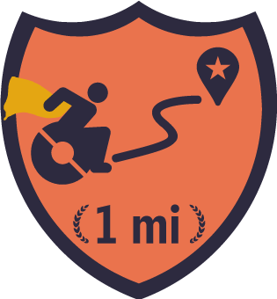
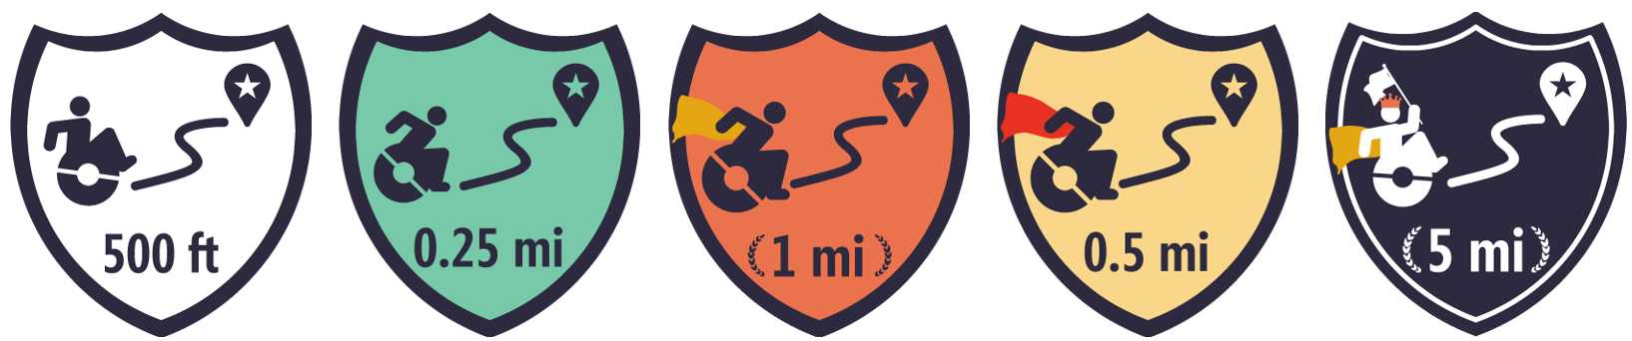
Dell Valle, MX
Your mission
Explore 500 ft of Dell Valle, MX. Find, label, and rate sidewalk accessibility features
Missions
Distance
Labels
Accuracy
Overall:
12
0.8 mi
1,123
83%
Dell Valle:
5
0.1 mi
98
93%
Missions: 12
20%
8 more missions until next mission badge!
Labels: 1,123
3%
430 more labels until next badge!
Distance: 0.8 mi
73%
0.2 more miles until next badge!

Slide 7

Dell Valle, MX
Your mission
Explore 500 ft of Dell Valle, MX. Find, label, and rate sidewalk accessibility features
Achievements
Missions: 12
20%
8 more missions until next mission badge!
Labels: 1,123
3%
430 more labels until next badge!
Distance: 0.8 mi
73%
0.2 more miles until next badge!
Missions
Missions
Distance
Labels
Accuracy
5th
Overall:
12
0.8 mi
1,123
83%
Let’s go!
Dell Valle:
5
0.1 mi
98
93%

Slide 8
Missions
Distance
Labels
Accuracy
Overall:
12
0.8 mi
1,123
83%
Dell Valle:
5
0.1 mi
98
93%
Dell Valle, MX
Your mission
Explore 500 ft of Dell Valle, MX. Find, label, and rate sidewalk accessibility features
Achievements
Missions: 12
20%
8 more missions until next mission badge!
Labels: 1,123
3%
430 more labels until next badge!
Distance: 0.8 mi
73%
0.2 more miles until next badge!
Missions
5th
Let’s go!

Slide 9
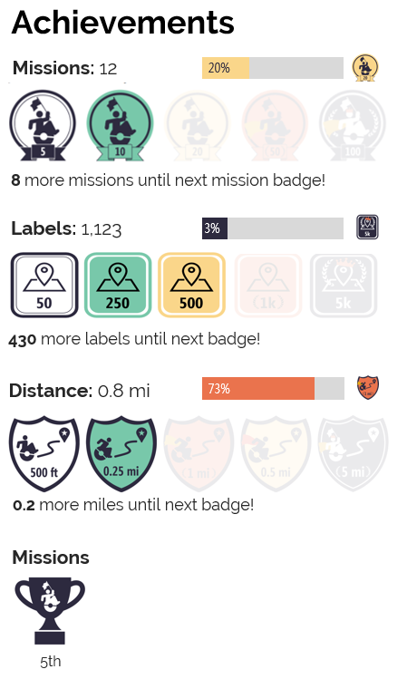
Missions
Distance
Labels
Accuracy
Overall:
12
0.8 mi
1,123
83%
Dell Valle:
5
0.1 mi
98
93%
Dell Valle, MX
Your mission
Explore 500 ft of Dell Valle, MX. Find, label, and rate sidewalk accessibility features
Let’s go!

Slide 11
Missions
Distance
Labels
Accuracy
Overall:
12
0.8 mi
1,123
83%
Dell Valle:
5
0.1 mi
98
93%
Dell Valle, MX
Your 13th mission
Explore 500 ft of Dell Valle, MX. Find, label, and rate sidewalk accessibility features
Achievements
Missions: 12
20%
8 more missions until next mission badge!
Labels: 1,123
3%
430 more labels until next badge!
Distance: 0.8 mi
73%
0.2 more miles until next badge!
Missions
5th
Let’s go!

Slide 12

Dell Valle, MX
Your 13th mission
Explore 500 ft of Dell Valle, MX. Find, label, and rate sidewalk accessibility features
Your Stats
Overall Rank
Missions
Distance
Labels
Accuracy
Dell Valle:
5
0.1 mi
98
93%
Overall:
12
0.8 mi
1,123
83%
Let’s go!

Slide 13
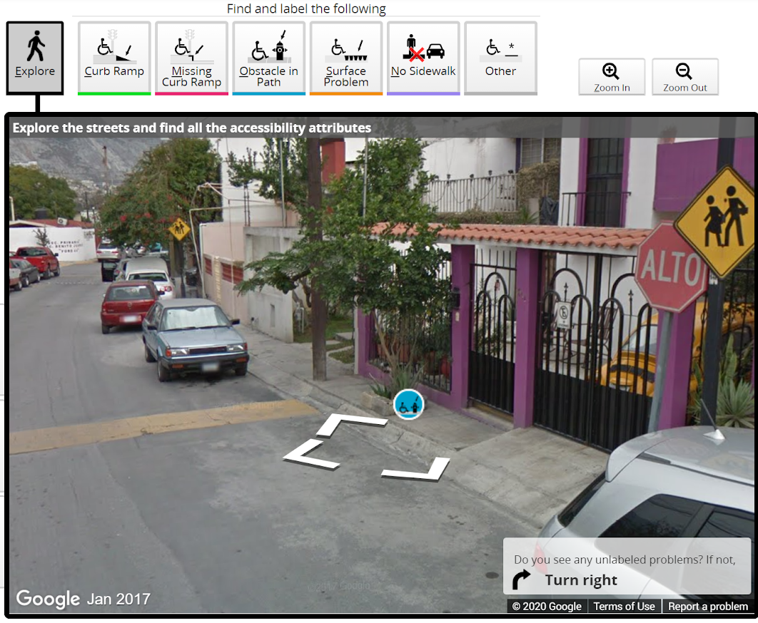
Missions
Distance
Labels
Accuracy
Overall:
12
0.8 mi
1,123
83%
Dell Valle:
5
0.1 mi
98
93%
Your 13th mission
Explore 500 ft of Dell Valle, MX. Find, label, and rate sidewalk accessibility features
Dell Valle, MX
Maybe show animated gif of common labeling mistakes?
Let’s go!

Slide 14
Missions
Distance
Labels
Accuracy
Overall:
12
0.8 mi
1,123
83%
Dell Valle:
5
0.1 mi
98
93%
Your 4th mission
Explore 500 ft of Dell Valle, MX. Find, label, and rate sidewalk accessibility features
Dell Valle, MX
Maybe show animated gif of common labeling mistakes?
Let’s go!

Slide 15
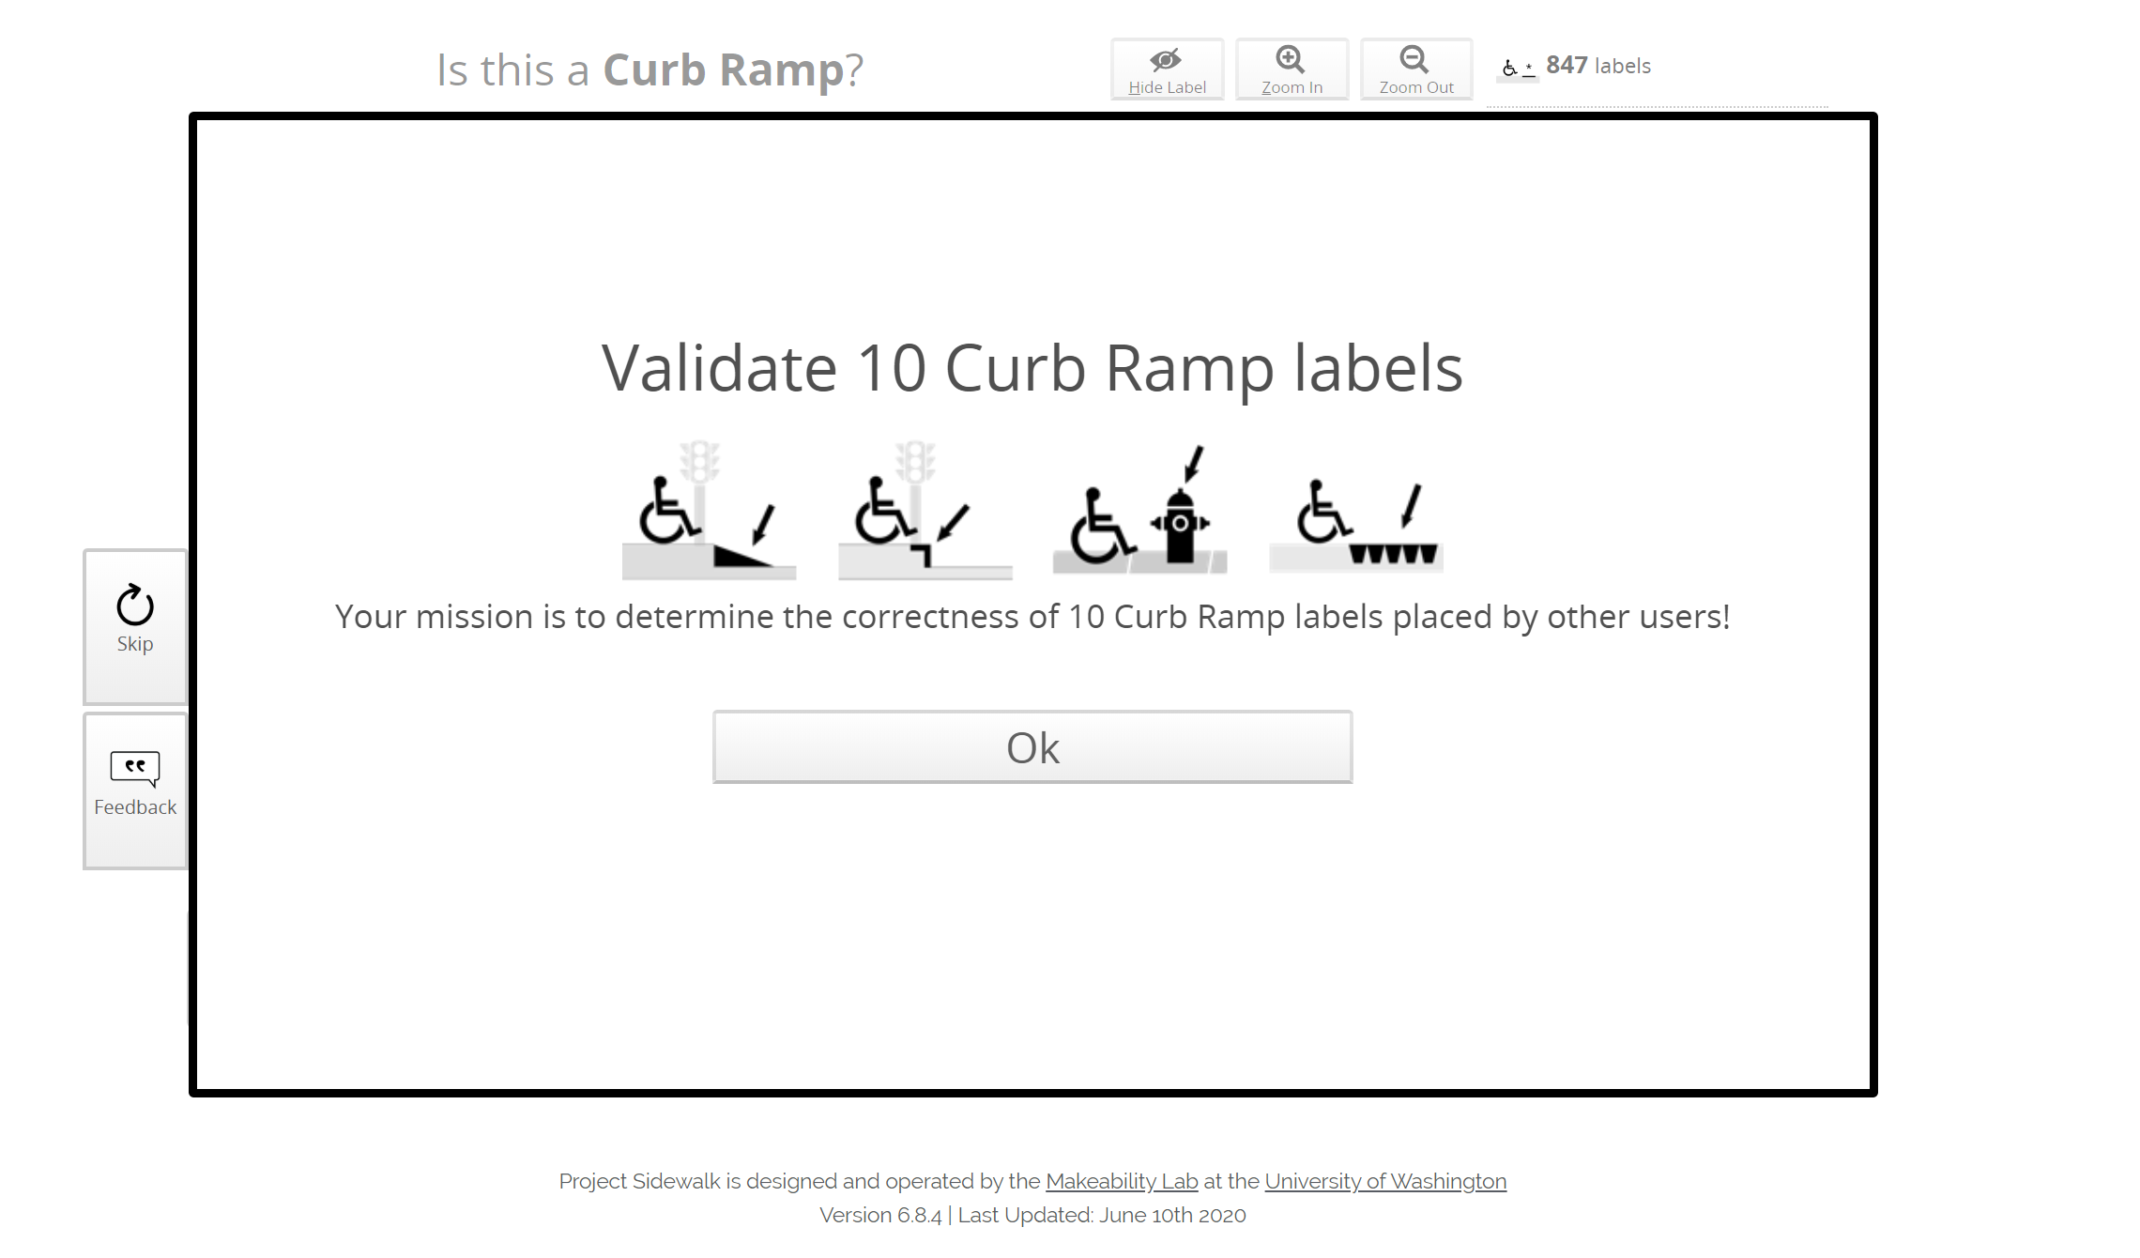

Slide 17
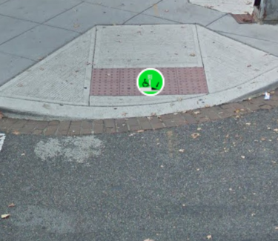
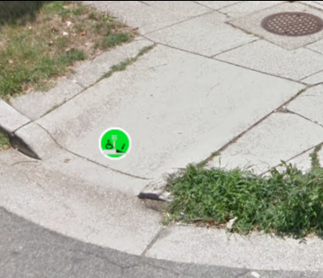
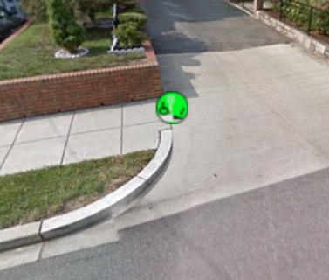
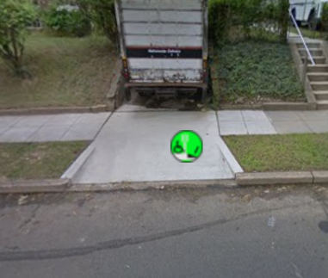
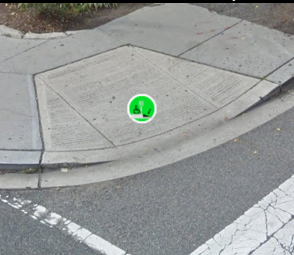


Your Mission: Validate 10 Curb Ramps
Correct examples. Mark Agree.
Incorrect examples. Mark Disagree.
Sidewalk-driveway transitions typically don’t need curb ramps
Driveways should not be marked as curb ramps
Start Mission: Validate 10 Curb Ramps

Slide 18
Your Mission: Validate 10 Curb Ramps
Correct examples. Mark Agree.
Incorrect examples. Mark Disagree.
Sidewalk-driveway transitions typically don’t need curb ramps
Driveways should not be marked as curb ramps
Start Mission: Validate 10 Curb Ramps

Slide 19
Validate 10 Curb Ramps
Correct examples. Mark Agree.
Incorrect examples. Mark Disagree.
Sidewalk-driveway transitions typically don’t need curb ramps
Driveways should not be marked as curb ramps
Let’s go!

Slide 20
Validate 10 Curb Ramps
Correct examples. Select “Agree”
Incorrect examples. Select “Disagree”
This is an ADA compliant curb ramp with wide flares, turnaround space, and a friction strip
This is a narrow curb ramp that is overly narrow and lacks a friction strip. But it’s still a curb ramp.
There is a smooth seam between the driveway and sidewalk, so a curb ramp is not needed.
Driveways should not be labeled as curb ramps
Let’s go!

Slide 21

Your Mission: Validate 10 Curb Ramps
Correct examples. Select “Agree”
Incorrect examples. Select “Disagree”
Correct label. This is an ADA compliant curb ramp with wide flares, turnaround space, and a friction strip
Correct label. This is a narrow curb ramp that is overly narrow and lacks a friction strip. But it’s still a curb ramp.
Incorrect label. Driveways should not be labeled as curb ramps. This is an extremely common labeling mistake!
Incorrect label. There is a smooth seam between the driveway and sidewalk, so no curb ramp exists.
Let’s do it!

Slide 22
Your Mission: Validate 10 Curb Ramps
What if we put more badge and leaderboard information on this? I think that would be good!
Correct examples. Select “Agree”
Incorrect examples. Select “Disagree”
Correct label. This is an ADA compliant curb ramp with wide flares, turnaround space, and a friction strip
Correct label. This is a narrow curb ramp that is overly narrow and lacks a friction strip. But it’s still a curb ramp.
Incorrect label. Driveways should not be labeled as curb ramps. This is an extremely common labeling mistake!
Incorrect label. There is a smooth seam between the driveway and sidewalk, so no curb ramp exists.
Start mission!

